Slide 1


Perform Boundary Traversal on a Binary Search Tree (BST)
Mr. Prakash Kumar Pandey
Assistant Professor
Artificial Intelligence & Data Science

Slide 2
Lesson Plan
Subject/Course | Competitive Coding
Lesson Title | Boundary Traversal on a Binary Search Tree (BST)
Lesson Objectives
Understand the concept of boundary traversal in a binary tree or BST
Learn how to print all nodes appearing on the boundary (outline) of the tree.
Implement boundary traversal using a combination of traversal methods.
Analyze time and space complexity and understand its real-world significance in visualization and tree layout problems.

Slide 3
Problem Statement:
Given a Binary Search Tree (BST), print all the nodes that form its boundary traversal in anticlockwise order, starting from the root node.

Slide 4
Concept
  Boundary Traversal of a tree means printing all the nodes that appear on the outer boundary (visible from outside).
  The boundary includes:
    Left Boundary – Nodes on the left edge (excluding leaves).
    Leaf Nodes – All leaf nodes (from left to right).
    Right Boundary – Nodes on the right edge (excluding leaves, printed in reverse).
  This traversal forms the “perimeter view” of the tree — similar to tracing the tree outline clockwise.

Slide 5
Algorithm/Logic
Print Root Node (if not null).
Print Left Boundary: Traverse down the left side until reaching leaf nodes.
Print All Leaf Nodes: Perform an inorder traversal to print every leaf node.
Print Right Boundary (Bottom to Top): Traverse down the right side, collect nodes, and print them in reverse order.
Combine all results to form the boundary traversal sequence.

Slide 6
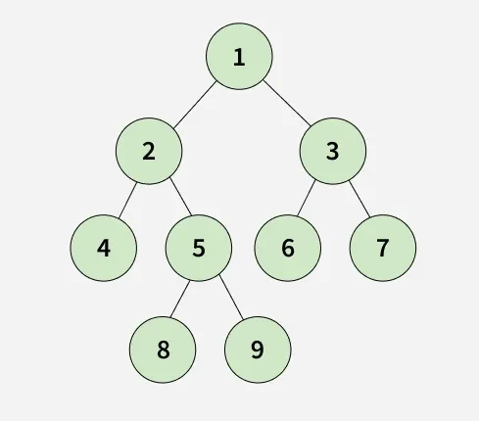
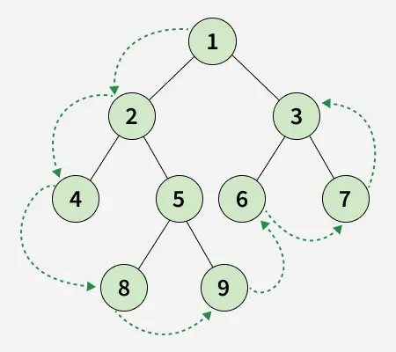
Visualization
Root → Left Boundary → Leaves → Right Boundary
Input :
Explanation:
Output : [1, 2, 4, 8, 9, 6, 7, 3]

Slide 7
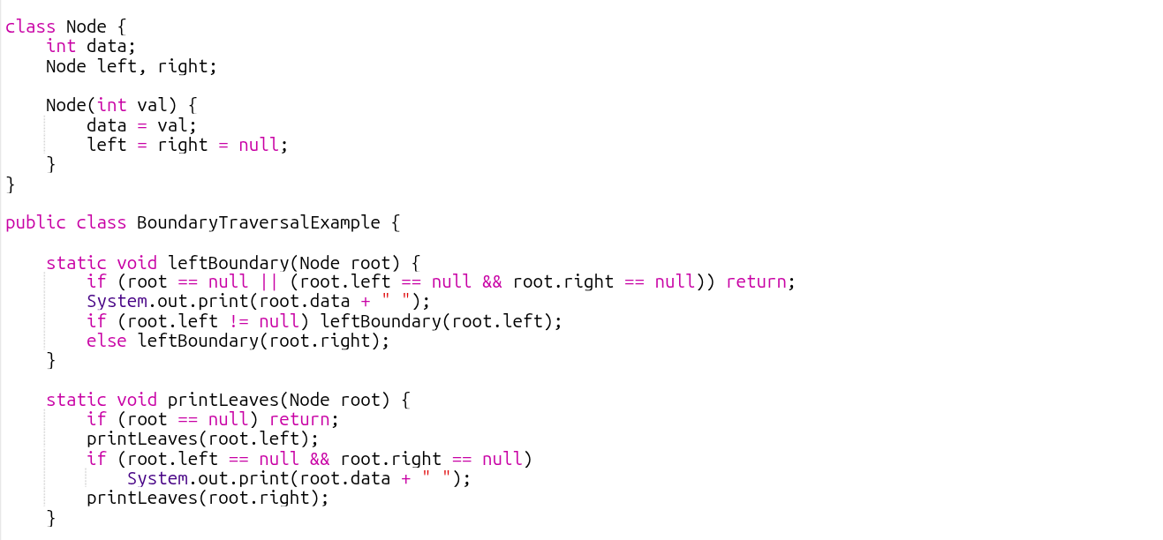
Code Implementation

Slide 8
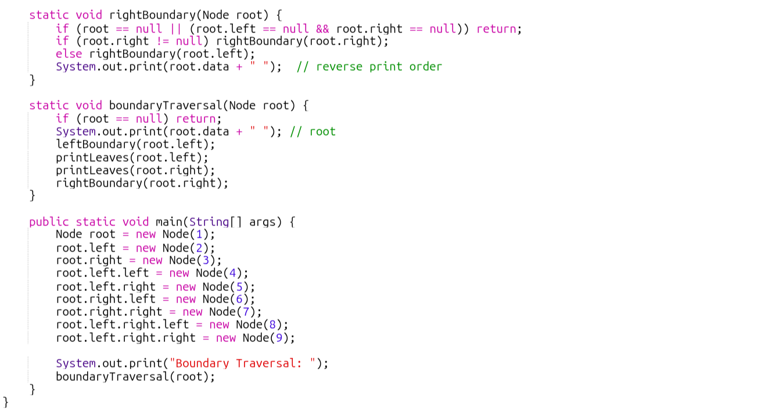

Slide 9

Output :

Slide 10
Time & Space Complexity
Operation | Time Complexity | Space Complexity | Explanation
Boundary Traversal | O(n) | O(h) | Each node is visited once; recursion depth = tree height (h).

Slide 11
Summary
Boundary Traversal helps extract the outermost visible nodes of a tree.
It combines left boundary, leaf nodes, and right boundary.
Time Complexity: O(n), as all nodes are visited once.
Useful in visual rendering, map boundaries, and tree shape analysis.

Slide 12
Practice Questions:
1. Boundary of Binary Tree — LeetCode #545
🔗 https://leetcode.com/problems/boundary-of-binary-tree/
Concept:
Print the complete boundary of a binary tree in anticlockwise order starting from the root.
Why Practice:
Strengthens understanding of multiple traversal combinations.
Helps in decomposition of complex traversal logic into manageable steps.

Slide 13
Thanks

